Slide 1
“It looks like you’re working out.”:
Using Machine Learning Classification Techniques to Predict Physical Stress
Eva Schwartz
DATS 4001: Data Science Capstone
April 2025

Slide 2

Have you ever looked down, and seen this even when you were not working out?

Slide 3
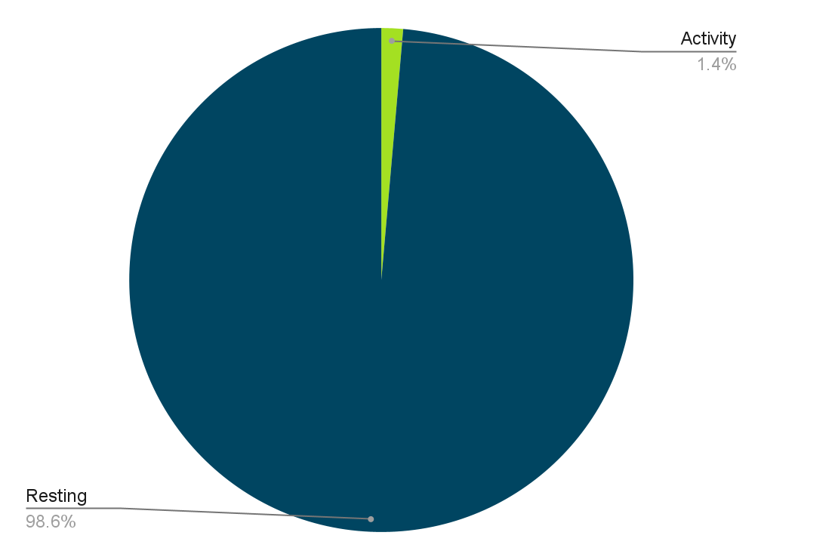
For average adults, the Center for Disease Control recommends “at least 150 minutes of moderate-intensity physical activity a week” but let’s put that into perspective…
150 minutes of recommended exercise in a week * 60 seconds in a minute
7 days in a week * 24 hours in a day * 60 minutes every hour * 60 seconds in every minute
… indicates that 1.4% of an average adult’s week should be dedicated to moderate-intensity physical activity

Slide 4
Given such a drastic imbalance in the class sizes of physical stress data, no wonder sometimes fitness wearables think that you are working out, even when you aren’t.
As someone who loves training and working out, comparing the performance of machine learning classifiers in imbalanced physical stress datasets quickly emerged as the topic of my Data Science Capstone.

Slide 5
Agenda
1
Review of Machine Learning Model Evaluation Metrics
2
Related Work
Methods
3
4
Implementation
5
Results
6
Limitations and Alternate Market Applications

Slide 6
Review of Machine Learning Model Evaluation Metrics
DATS 4001: Data Science Capstone
April 2025

Slide 7
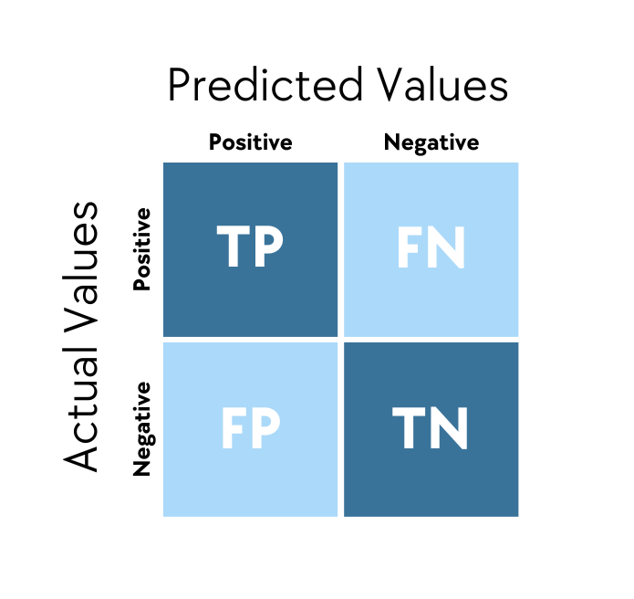
To classify model evaluation metrics, a confusion matrix is vital in understanding the performance of models in classification tasks
For this project, the true positive category is the majority, resting, non-active class and the true negative class is the physical stress, minority class
DATS 4001: Data Science Capstone
April 2025

Slide 8
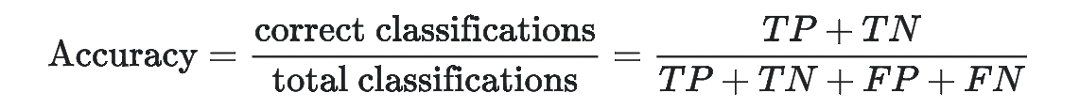
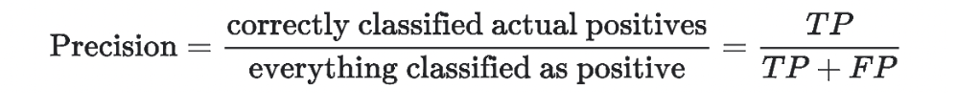
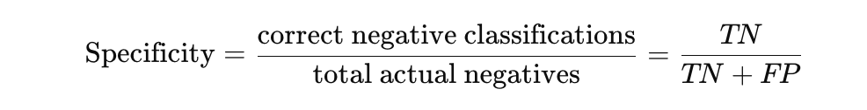
Useful, but in imbalanced datasets like the one used here, a false negative is more costly than a false negative, so metrics that are more focused can be more helpful
Focused on positive classifications, in this research, positives are the majority and are not the target class so not as helpful for this project
Also focused on positive classification, focused on reducing false negatives but the minority class for this data is the negative class and this metric is not as helpful in evaluating predictions for the negative class
Derives accuracy of negative predictions of models, inverse of precision, vital for this project as goal is predicting negative class
Focused on identifying how well a model identifies actual negative classes, very important in evaluating models in this research given the negative class is the minority in this project
DATS 4001: Data Science Capstone
April 2025

Slide 9
Related Work
DATS 4001: Data Science Capstone
April 2025

Slide 10

One team working on credit card fraud detection used a dataset with positive, minority class accounting for .2% of their dataset, they recommended assigning larger class weights to fraudulent transactions that they were looking to predict to increase the relative importance of this class in the model training process
A similar study focused on credit card fraud with .4% of values belonging to minority, fraudulent class used undersampling to balance data, then compared a decision tree, random forest, and logistic regression model with random forest having the strongest performance
A study focused on emotional and physical stress found that heart rate and electrodermal activity were strong predictors of stress - both mental and physical
DATS 4001: Data Science Capstone
April 2025

Slide 11
Methods
DATS 4001: Data Science Capstone
April 2025

Slide 12
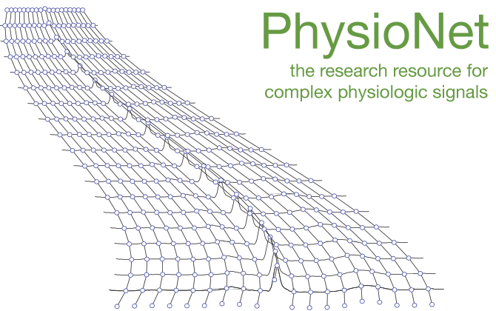
Dataset
Data courtesy of PhysioNet and is publicly available
Original features include electrodermal activity, temperature, acceleration, race, heart rate, and arterial oxygen level
The data were collected using noninvasive wrist-worn Empatica biosensors.
Dataset consisted of 20 subjects, with 30% of the sample as female subjects, and a mean overall age of 26.05 years
Data was collected in 7 stages
Stage 2 as physical stress stage, where subjects were instructed to “stand for one minute, walk on a treadmill at one mile per hour for two minutes, then walk/jog on the treadmill at three miles per hour for two minutes.”
DATS 4001: Data Science Capstone
April 2025

Slide 13
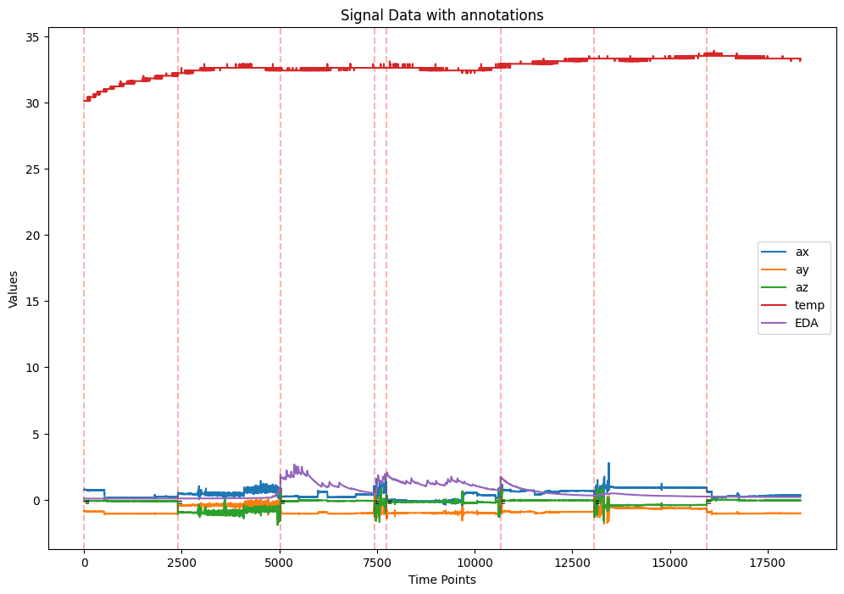
Signal processing and data processing
Conversion of raw data signals to tabular data
Synching of dataframes → HR/SP02 and acceleration, temperature, and EDA data
Isolation forest outlier detection
Finds anomalies by detecting how far a given data point is from the rest of the data
Outlier detection is primarily exploration focused given the inherent variability of health data
DATS 4001: Data Science Capstone
April 2025

Slide 14
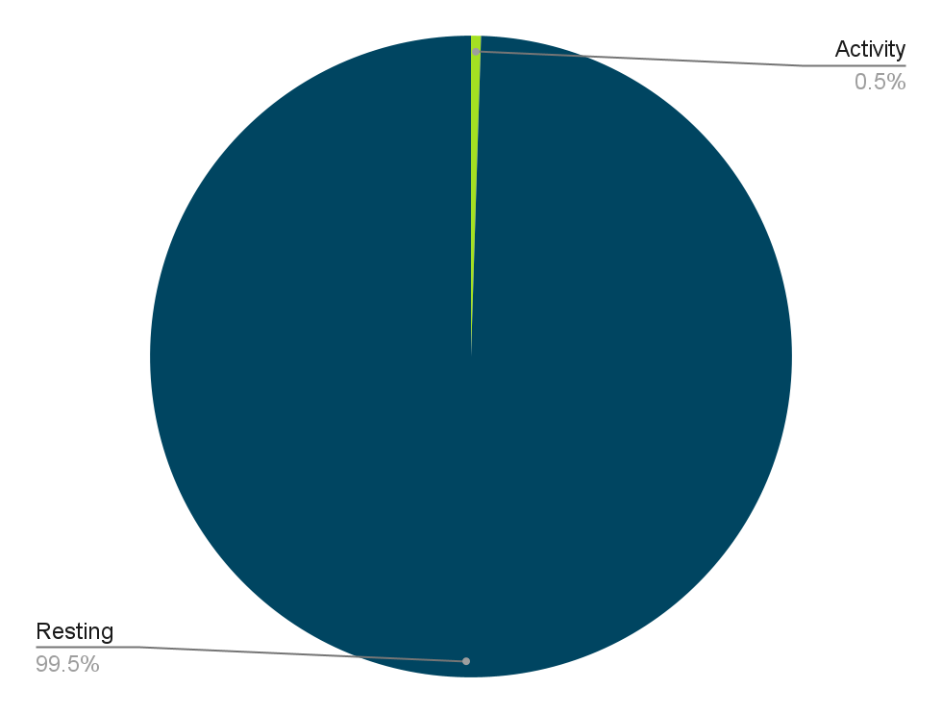

Feature extraction
Extraction of physical stress variable, with data imbalance seen in pie chart to the top right
Acceleration magnitude extraction from acceleration variables as seen in formula in the bottom right
Ratio of a subjects heart rate to their acceleration magnitude to indicate intensity of a subjects physical activity
Ratio of body temperature to electrodermal activity given strong, complex relationship between these two variables
DATS 4001: Data Science Capstone
April 2025

Slide 15
Experiments and Implementation
DATS 4001: Data Science Capstone
April 2025

Slide 16
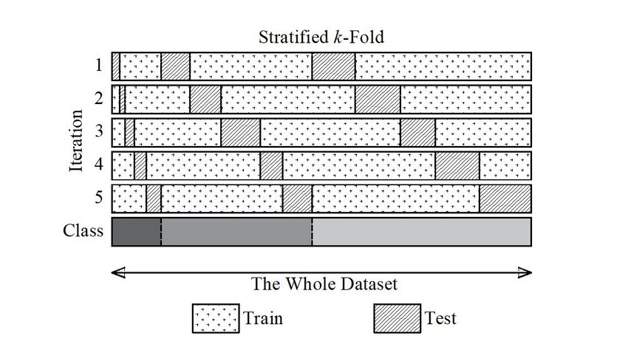
To perform robust cross-validation while ensuring each training model receives an even distribution of minority class data, I used stratified K-fold cross validation techniques.
K number of folds are initialized, data is split by class as seen in the bottom row of the image to the right, then data is sequentially added to each fold to ensure that cross validation techniques are robust and represent the original data distribution. I used 3 inner folds for tuning hyperparameters, then 5 outer folds for training and testing models.

Slide 17
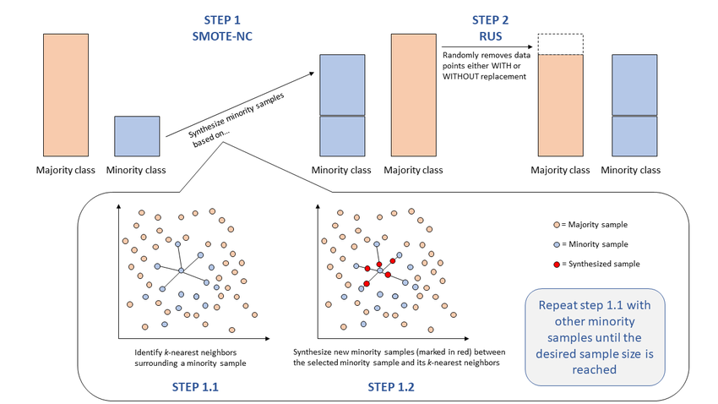
SMOTETomek Hybrid Resampling
Data is unbalanced so need to use resampling methods to augment minority class
SMOTETomek hybrid resampling uses SMOTE resampling to synthetically generate minority class pointswhile using Tomek Link undersampling, as seen in the image to the left, to remove samples of the majority class using nearest neighbor techniques to find excess majority class points
Following SMOTETomek resampling, MinMaxScaler was implemented in the pipeline to scale data given data was collected in different scales
DATS 4001: Data Science Capstone
April 2025

Slide 18
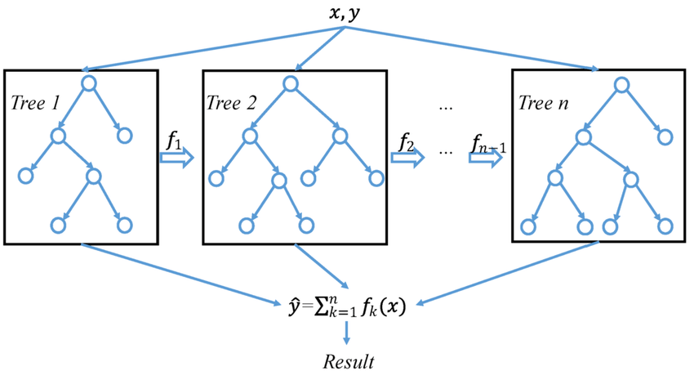
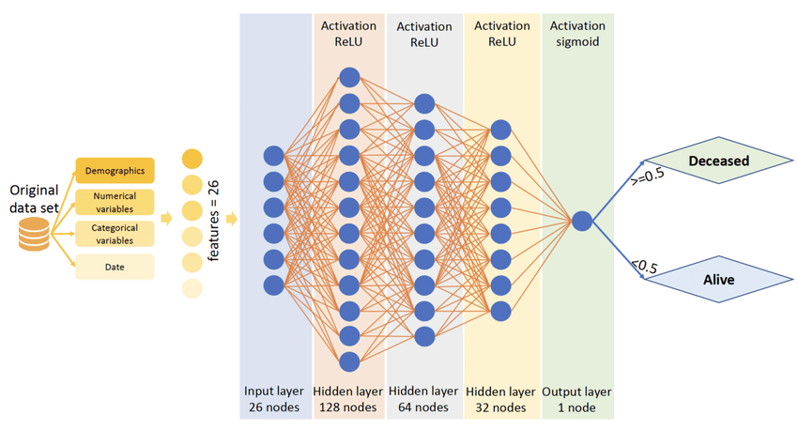
Models Used
To find the best hyperparameters for each model, RandomizedSearchCV was used in the tuning step. Best performing hyperparameters for each fold of training can be found in the appendix.
Logistic regression
Random Forest
XGBoost - architecture in top right
Histogram Gradient Boosting
Multi-Layer Perceptron - architecture in bottom right
DATS 4001: Data Science Capstone
April 2025

Slide 19
Results
DATS 4001: Data Science Capstone
April 2025

Slide 20
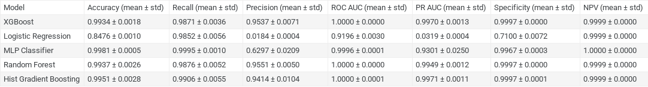
Summary of model results
Random Forest and XGBoost both had strong specificity and negative predictive value metrics. The Multi-Layer Perceptron model had the highest negative predictive value, though the difference between models in this metric is very small. The weakness of Logistic Regression when comparing metrics is fairly clear, though this is to be expected given the simplicity of this model.
DATS 4001: Data Science Capstone
April 2025

Slide 21
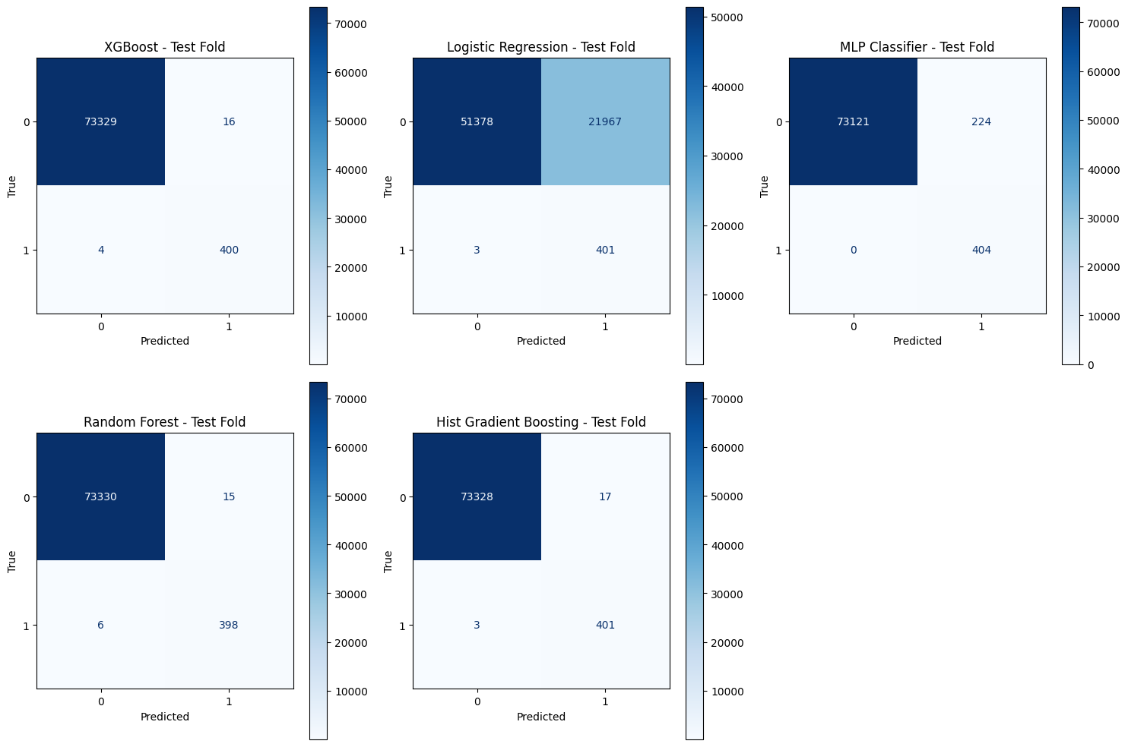
Darker blue shades indicate higher class counts here.
Confusion matrices align with conclusions from model evaluation metrics
Basic models like logistic regression suffer in classifying even the majority class, while models like MLP, Histogram Gradient Boosting, and XGBoost are strong in classifying true positives and true negatives
DATS 4001: Data Science Capstone
April 2025

Slide 22
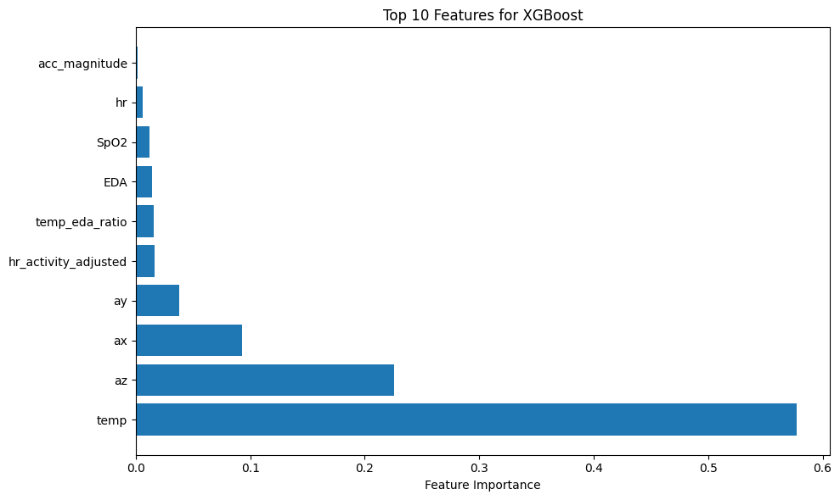
Body temperature indicates very strong importance in predicting physical stress for the XGBoost model, followed by z-axis acceleration, measuring forward and backward movement
DATS 4001: Data Science Capstone
April 2025

Slide 23
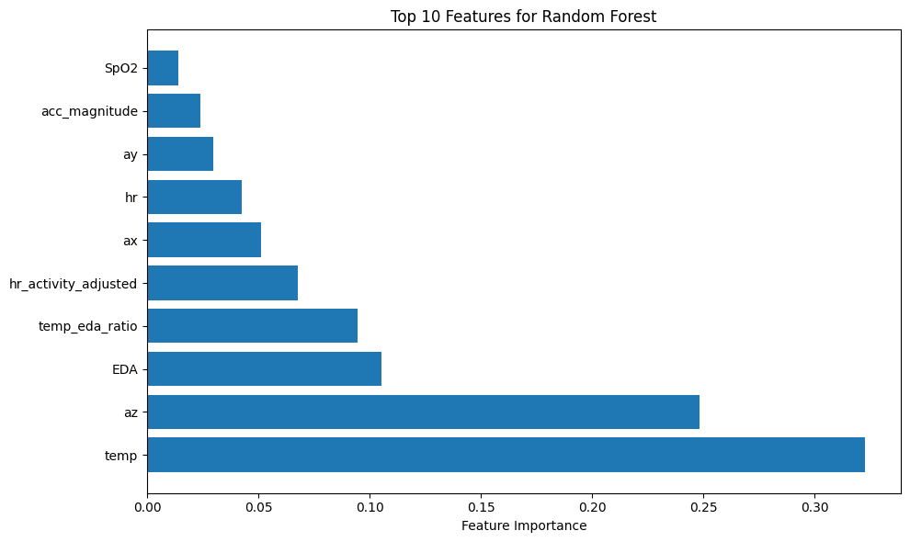
Random Forest feature importance shows similar feature importance variables as XGBoost, though temperature’s importance is less than XGBoost and EDA emerges as an additional important feature
DATS 4001: Data Science Capstone
April 2025

Slide 24
Limitations and Alternate Applications
DATS 4001: Data Science Capstone
April 2025

Slide 25
Limitations
Lack of female representation in the dataset
Inherent difficulties in predicting extremely imbalance datasets → some false positives sneak through even on very well developed models and products
Multi-layer perceptron is a good model, but it operates as a “black box,” meaning there is not much information on how the hidden layers work
DATS 4001: Data Science Capstone
April 2025

Slide 26


Alternate Applications
Model comparison research can be used in predicting cyber attacks, especially because cyber attacks also generally suffer from imbalanced data in training
This research could be applied to disease/medical prediction given the health focus of the model development and the focus on optimization of machine learning models for imbalanced datasets
DATS 4001: Data Science Capstone
April 2025

Slide 27
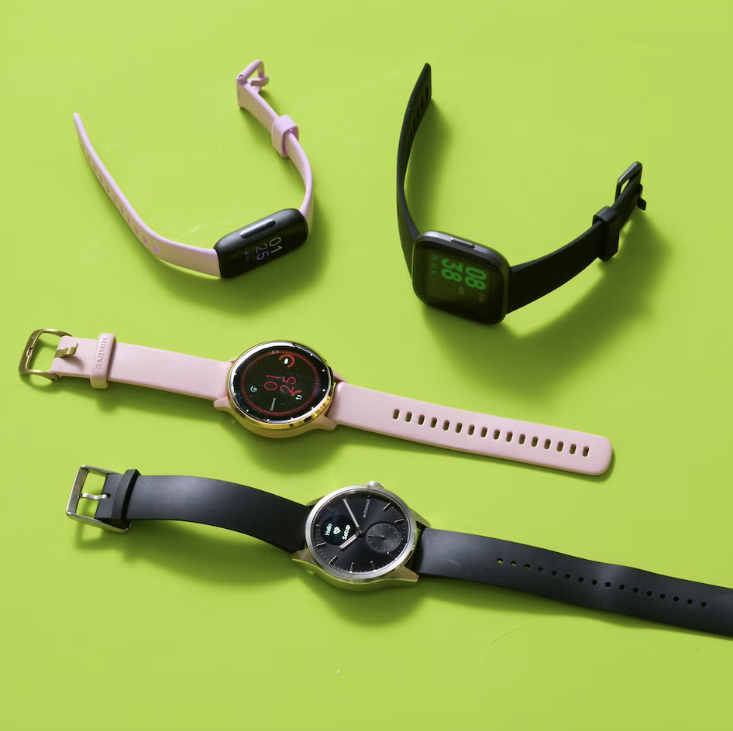
Conclusion
Multi-layer Perceptron, Random Forest, and XGBoost are all strong models for this task
Implementing lighter, faster models like LightGBM for classifying physical stress could be a powerful next step for this body of research
Temperature emerged as a very important factor in predicting physical stress across models therefore correctly calibrating and developing wearables sensors to accurately predict body temperature is vital in deploying this research to fitness wearables.
An interesting exploration for this research would be to compare the results of these models to those gathered from a female-dominant biosignal dataset
Issue is lack of female representation in biosignal and physiological datasets
DATS 4001: Data Science Capstone
April 2025

Slide 28
Q&A
Any questions?

Slide 29
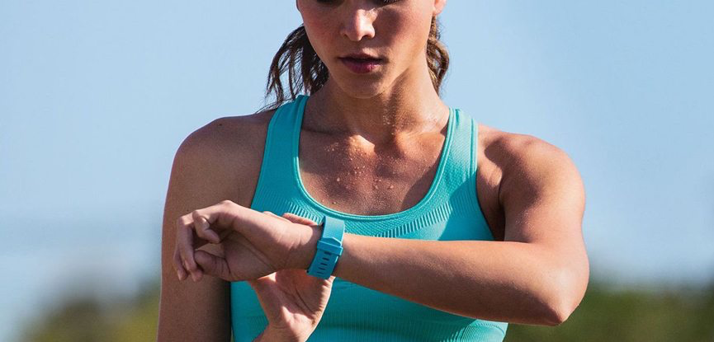
Thank You!

Slide 30
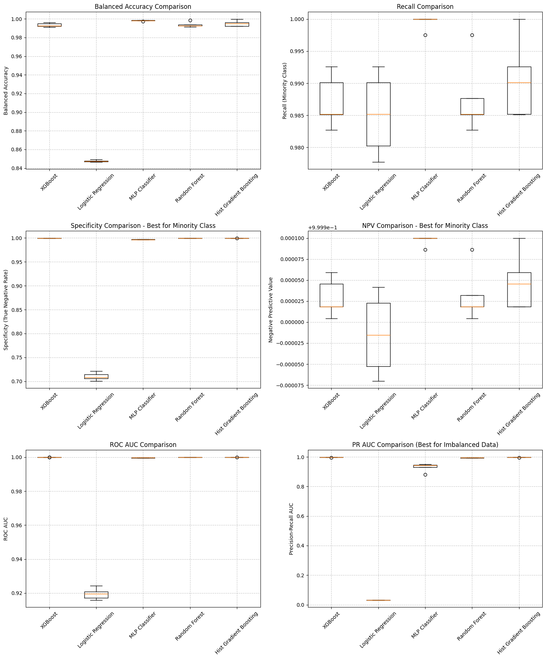
Appendix 1: training model evaluation metrics

Slide 31
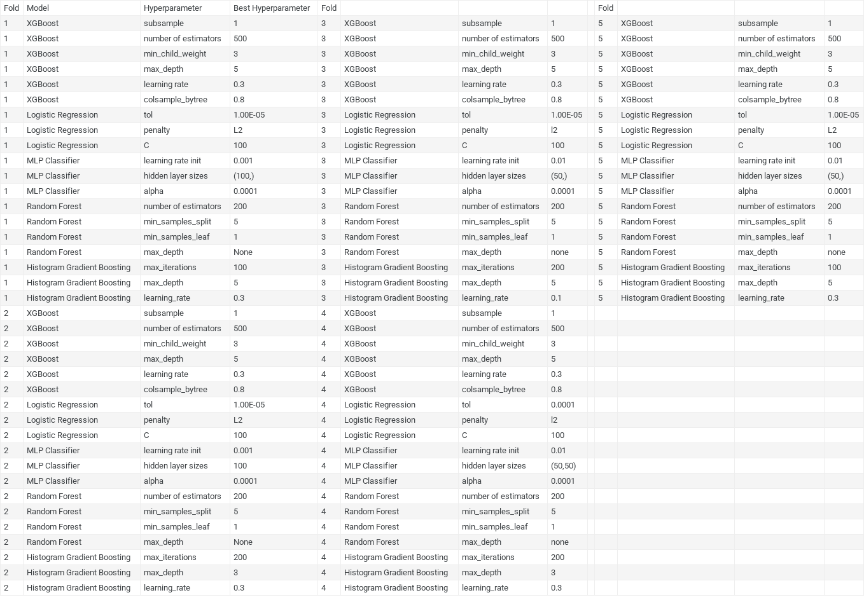
Appendix 2: Model hyperpar-ameters by fold

Slide 32
References for images
Full reference can be accessed through this project’s GitHub in the Full Report: https://github.com/GW-datasci/25-spring-ESCHWARTZ/tree/main
A Study of Fitness Trackers and Wearables
Hybrid resampling process. | Download Scientific Diagram

